Slide 1
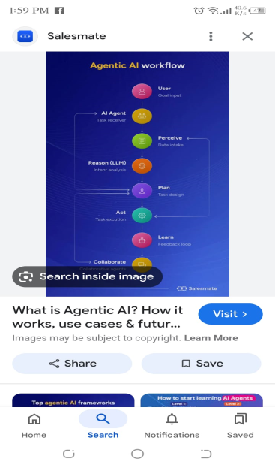
Agentic ai
Agentic AI refers :
Autonomous AI systems-agents-capable of setting goals reasoning actingand learning over time with minimal human suprivation

